Slide 1


Enhancing mmWave Radar Sensing Using a Phased-MIMO Architecture
Kai Zheng¹, Wuqiong Zhao¹, Timothy Woodford¹, Renjie Zhao¹, Xinyu Zhang¹, Yingbo Hua²
¹ Electrical and Computer Engineering
² Electrical and Computer Engineering
Notes:
Thanks for the introduction.

Slide 2
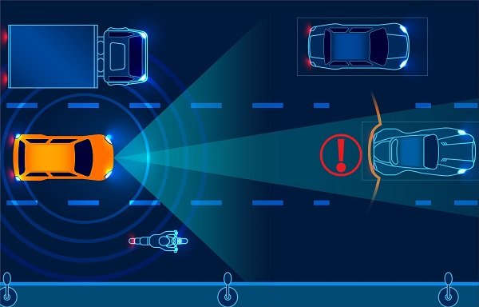
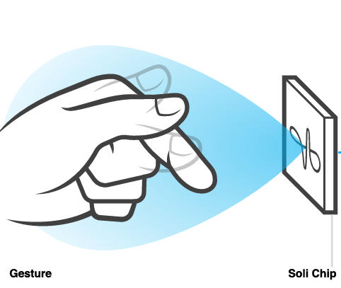
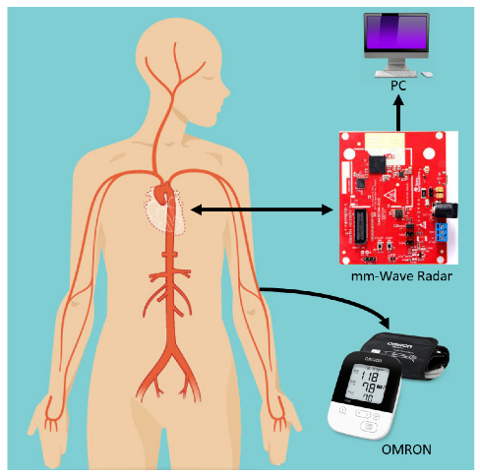
mmWave Radar Sensors
Applications of mmWave radar sensors:
Automotive Perception
Gesture Operation
Vital Sign Monitoring
Advantages: high range resolution, small form factor, sensitivity to small movement, and all-weather and light operation.
Notes:
In recent years, we have seen an increased growth of mmWave radar sensors in various applications, such as automotive perception, gesture recognition and vital sign monitoring.
mmWave radar sensors enjoy many advantages, such as …

Slide 3
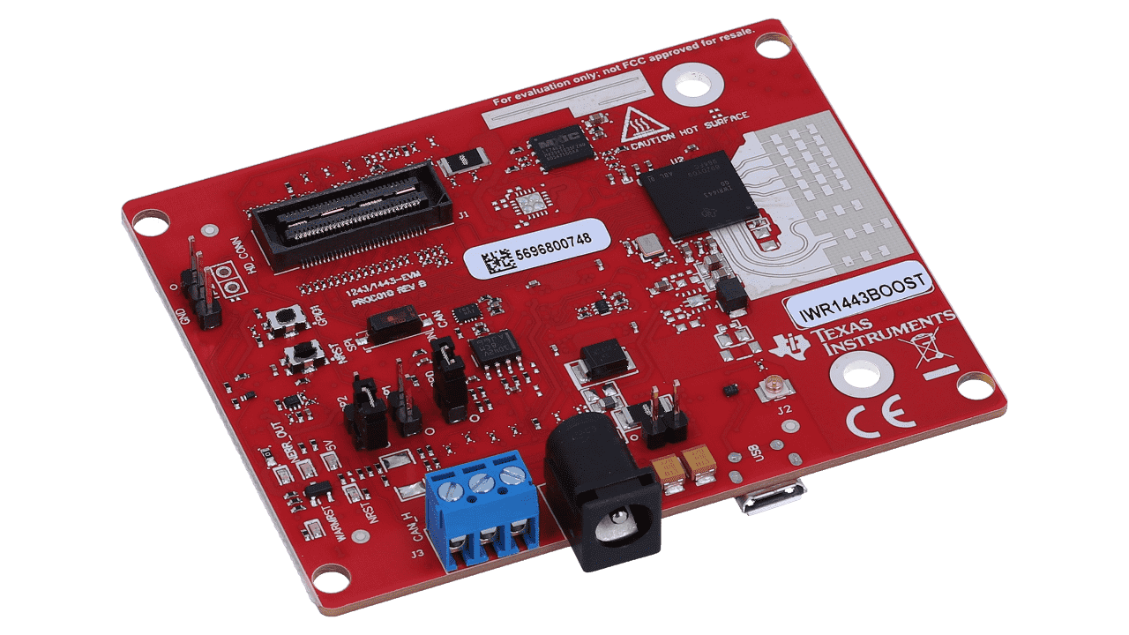
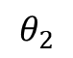
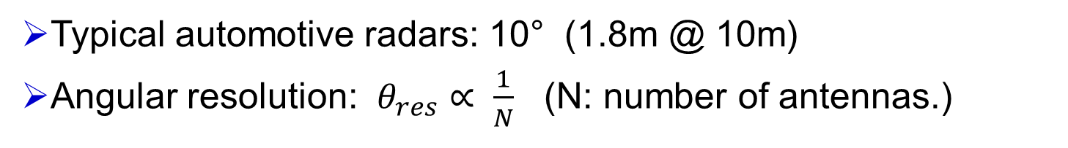
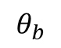
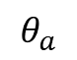
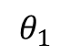
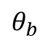
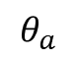
Challenge: Limited Angular Resolution
P
d
a
Angular Analysis
$$θ_{1}$$
Radar detects two targets.
d
b
P
$$θ_{a}$$
$$θ_{b}$$
AoA
Angular Analysis
d
a
Radar detects only one target.
$$θ_{2}$$
b
d
$$θ_{a}$$
$$θ_{b}$$
AoA
Typical automotive radars: 10° (1.8m @ 10m)
Angular resolution: $θ_{res}∝ \frac{1}{N}$ (N: number of antennas.)
Notes:
However, there is a main challenge that mmWave radar sensors are facing, which is the limited angular resolution.
If there are two targets, at the same distance, and if they are separated sufficiently, the radar sensor can distinguish them and can detect two targets.
However, if the targets are too close to each other, and the angular separation is larger than the angular resolution, the two targets are going to merge to one for the radar. Consequently, the radar only detects one target.
Commonly used automotive radars only have a angular resolution of 10 degree, which corresponds to a separation of 1.8m at the distance of 10m.
The angular resolution needs to be improved to support a wider applications of mmWave radar sensors.
The most direct way to improve the angular resolution is employing more antennas as the angular resolution value is inversely proportional to the number of antennas.

Slide 4
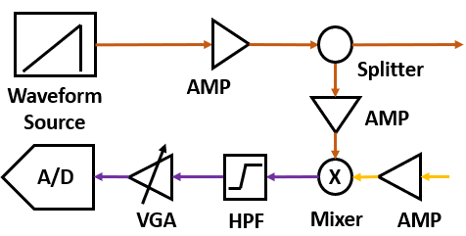
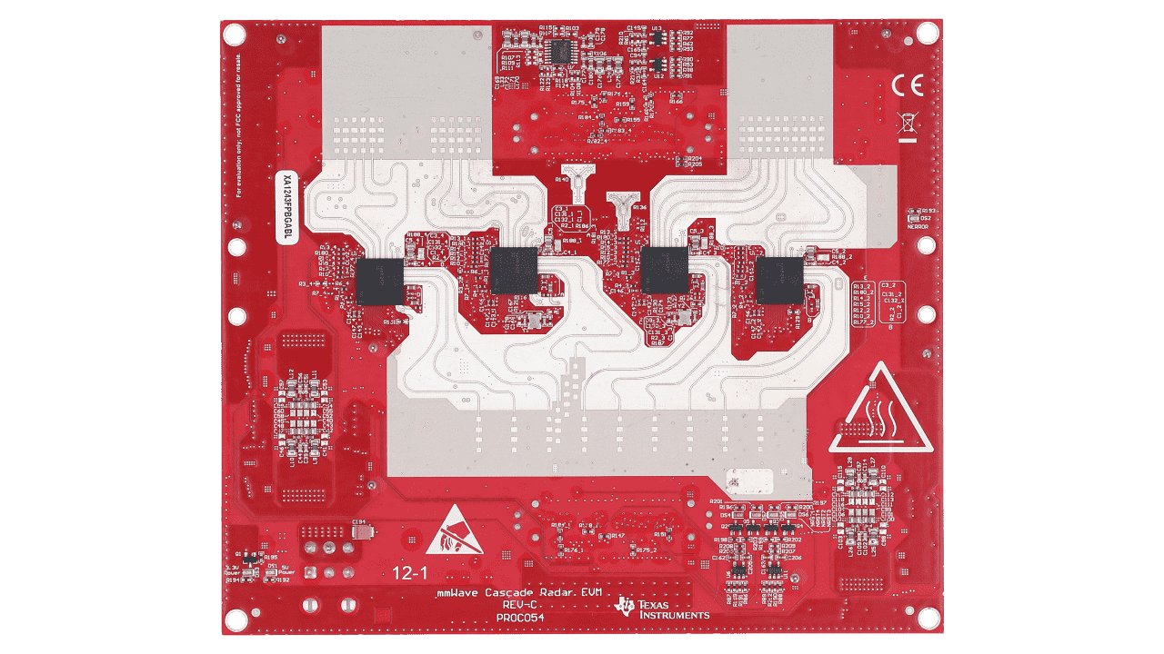
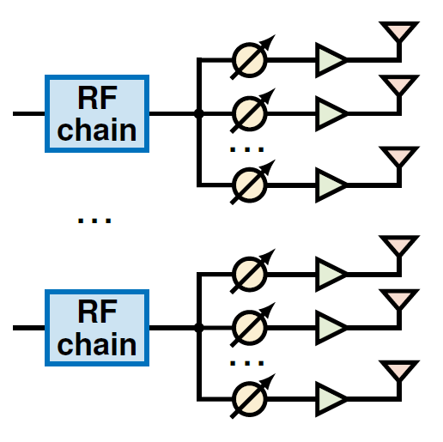
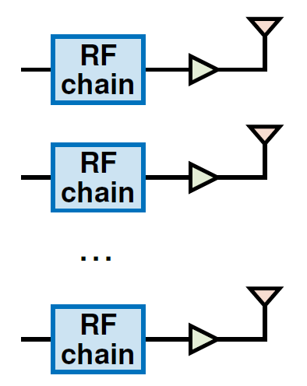
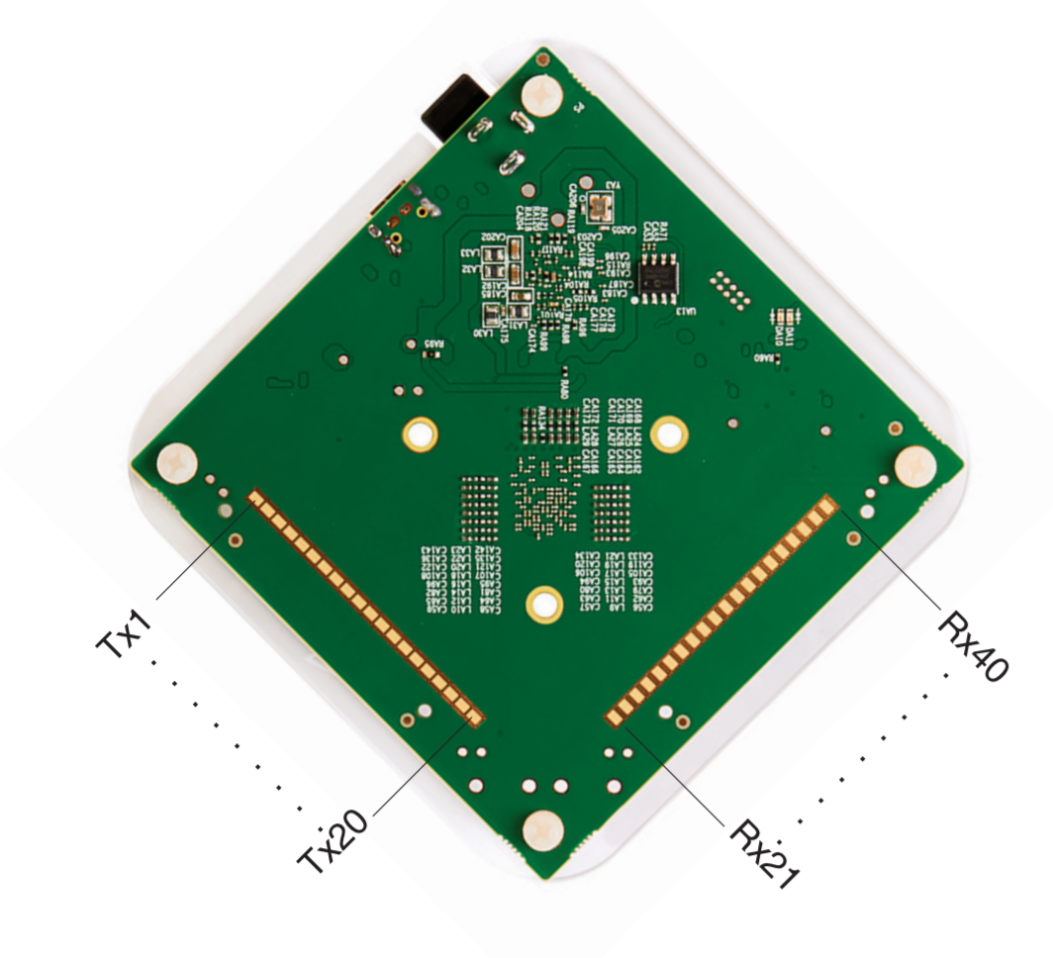
Existing mmWave Radar Platforms
Complex, expensive
Simple, cheap
TI: MMWCAS-RF
12Tx, 16Rx
No available platform ☹
Minicircuits: VTRIG-74
20Tx, 20Rx
Full-MIMO Architecture
Phased-MIMO Architecture
Hard to scale up the antenna count.
Can easily scale up to 100s of antennas.
Notes:
However, boosting the number antennas is not straightforward as it can cause complexity to the system.
However, the degree of freedom in phased-MIMO radar sensing remains largely underexplored. Examples include waveform configuration, beam pattern (codebook) design, phased array geometry, baseband processing algorithms, etc.
1 antenna = 1 RF chain, and it is expensive. The antenna count is non-scalable.
The antenna count is scalable (~100s of elements). Remains underexplored for radar sensing!

Slide 5
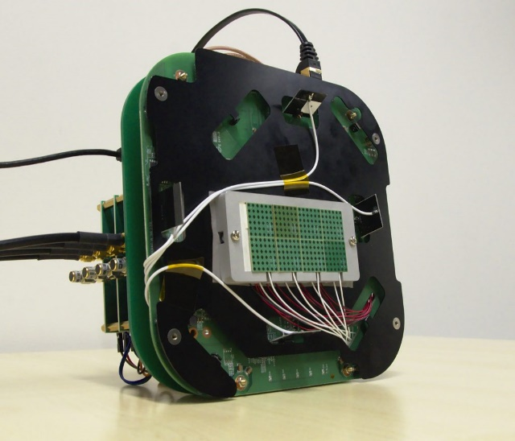
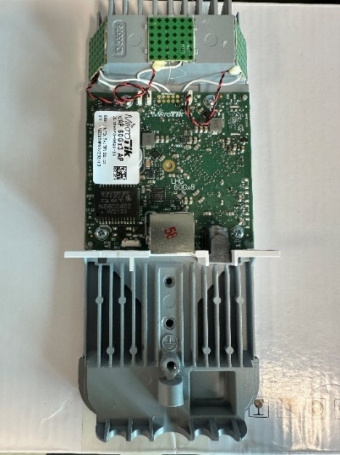
The HybRadar Platform
A mmWave radar research platform with hybrid MIMO-phased array architecture.
Platform Capability
Bandwidth (GHz) | 58-62
Number of Tx/Rx Channels | 8
Antennas per Channel | 32
Total antenna | 256
Beamformer | 2-bit phase, 1 bit amp.
Airfide Sparrow+
Mikrotik wAP x3
Commodity mmWave radios (802.11ad/ay)
Notes:
Therefore, to fill the gap, we propose *hybRadar*, a mmWave radar research platform with hybrid MIMO-phased array architecture.
HybRadar has a wide bandwidth from 58-62 GHz. It has a total of 8 independent channels, each is connected to a phased-array of 32 antenna elements.
The total antenna count can reach up to 256.
To save the engineering effort, we did not design from scratch. Instead we start from the commodity mmwave radios, such as Airfide Sparrow+ or Mikrotik radios, hack them and turn them into a radar platform.

Slide 6
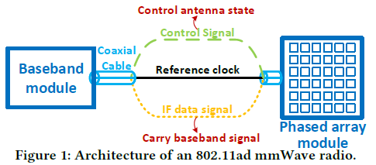
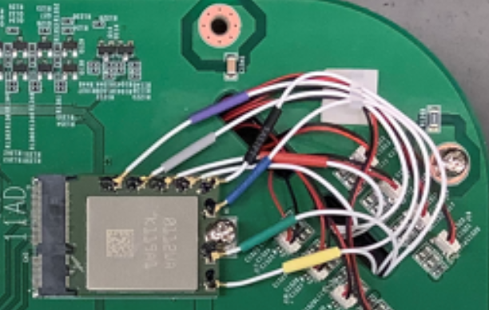

Retrofitting the 802.11ad Radio
Real-time PAM Control Signal
118MHz
802.11ad NIC
7.5GHz
802.11ad Network Interface Card
~15GHz
60GHz Phased Array Module
(6x6)
*4 corner antennas are unusable
Radar Waveform (13-17GHz)
[1] Zhao, Renjie, et al. "M-cube: A millimeter-wave massive MIMO software radio." Proceedings of the 26th Annual International Conference on Mobile Computing and Networking. 2020.
Notes:
Limitation of the commodity radio:
Only protocol-compliant waveform
Pre-defined beampatterns
No real-time control. ☹
We modify it and retrofit it into an mmWave radar platform.

Slide 7
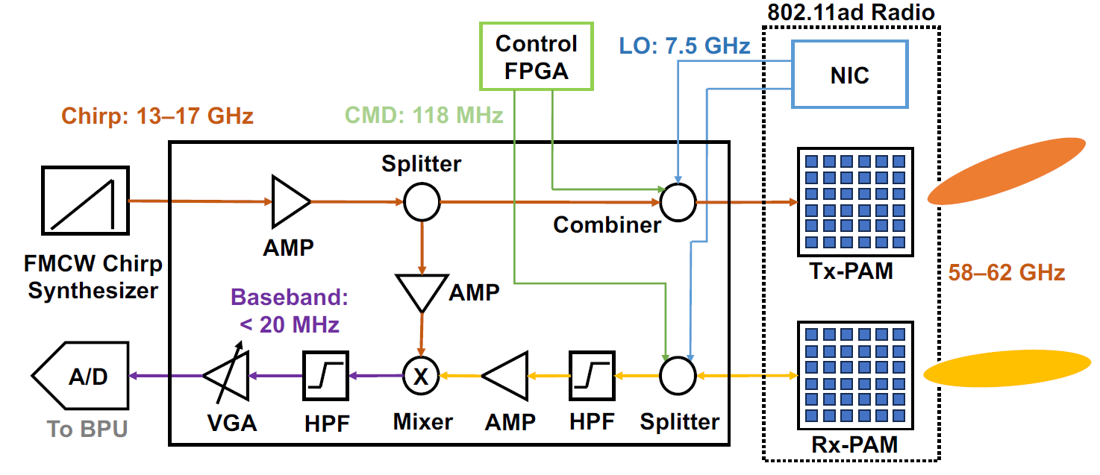
Single-Channel HybRadar Design
Implemented based on ADF4159 evaluation board
FPGA: real-time beam pattern control
Up-convert to mmWave and perform beamforming
Implemented using USRP N210
FMCW radar front-end PCB
Performs standard FMCW function: signal amplification, mixing and filtering
Combine the CTRL, LO and FMCW chirp signal
Notes:
We designed a board for FMCW signal synthesis and mixing.

Slide 8
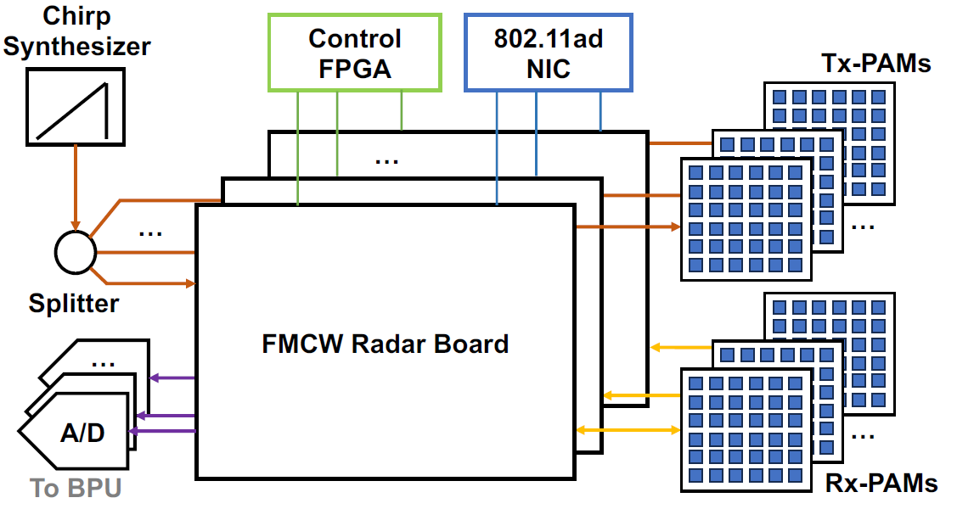
Multi-Channel HybRadar Design
Modular design ensures scalability to multiple channels.
Can support up to 4Tx-4Rx channels (128+128 antennas)
Notes:
(max. 128 Tx + 128 Rx)

Slide 9
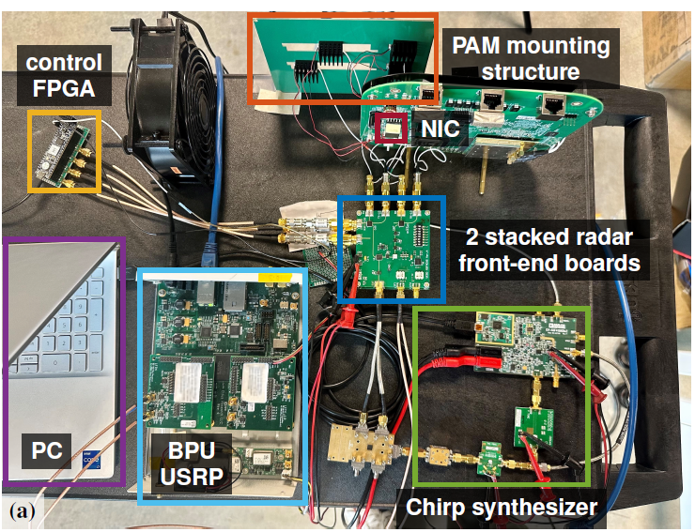
System Photo
Notes:
We have also designed a phased array mounting board to facilitate different phased layout.

Slide 10
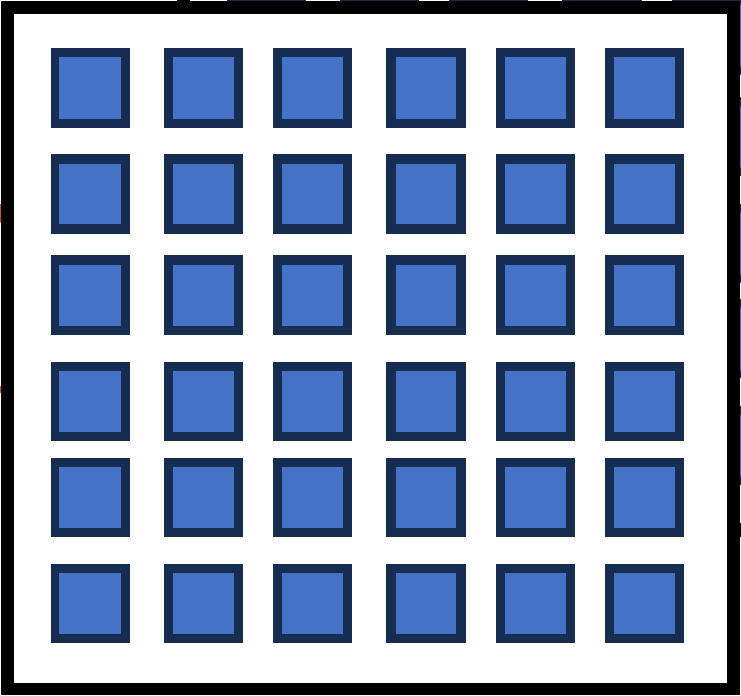
Sparse Array Design
Fully-populated array
Sparse array
A sparse array can synthesize a large “virtual array”.
Types of virtual array:
Sum Co-array, Difference Co-array, Difference Co-array of Sum Co-array.
We explore the design of a sparse “array of phased-arrays”.
Notes:
The layout of the antennas in a radar system has a direct impact on the angular resolution. It is therefore essential to study the optimal layout of the phased arrays in a phased-MIMO radar system.
As compared with a fully-populated array, a sparse array comprises antennas with very large spacing.
By employing signal processing techniques, we can synthesize a virtual array, which is much larger than the physical array size. This enables the radar to achieve superior angular resolution.
There are in general three types of virtual array: … .
These types of arrays have been studied in the general case of full-MIMO radar.
However, the phase-MIMO radars have a array of phased-array structure, which places extra constraints of the location of the antennas, and therefore the optimal layout of the phased arrays needs further investigation.
Next, we explore the design of the sparse

Slide 11
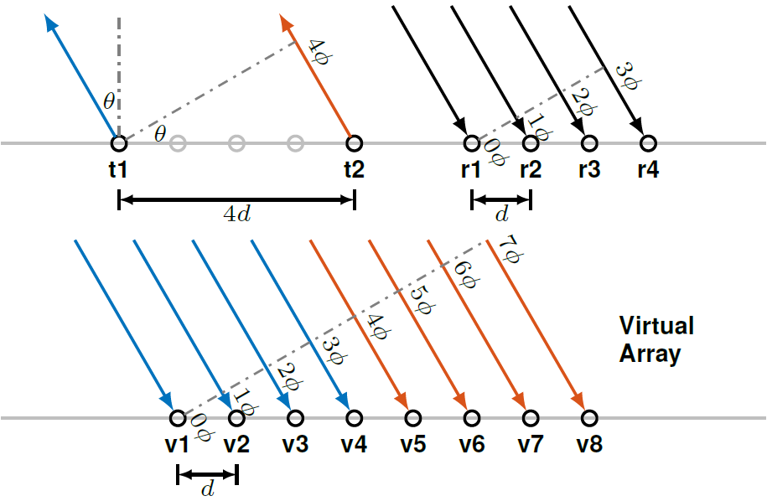
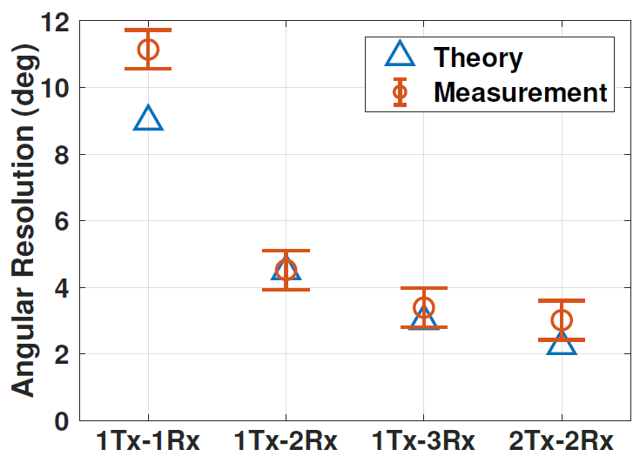
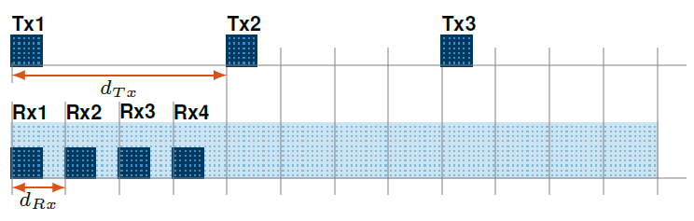
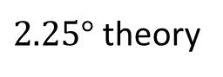
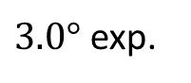
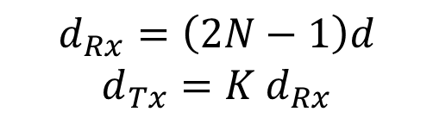
The Sum Co-Array (SCA)
Employed in active radar sensing.
Represents the sum of the spatial locations of pairs of Tx-Rx elements in a physical sensor array.
Proposed SCA structure:
Linearly-Spaced Array of Subarrays
2T-2R horizontal Virtual elements: 44
$2.25°$ theory
$$d_{Rx}=\left(2N−1\right)d$$
$$d_{Tx}=K{ d}_{Rx}$$
$3.0°$ exp.
Notes:
The first type of the virtual array is the Sum Co-Array, which is widely employed in active radar sensing.
Represents the sum of the spatial locations of pairs of elements in a physical sensor array.
For example, if we have two Tx antennas spaced by 4d and four Rx antennas spaced by 1d, the resulting sum co-array would be an array of eight elements.
For the HybRadar system, we propose a linearly-spaced array of subarrays structure.
The pitch of the Rx phased-arrays is (2N-1)d, N=6 is the number of antenna in one direction. Then d_Tx equals K times d_Rx where K is the number of Rx phased-arrays.
We did experiments to measure the angular resolution the radar. The result shows that the angular resolution improves with more phased arrays.

Slide 12
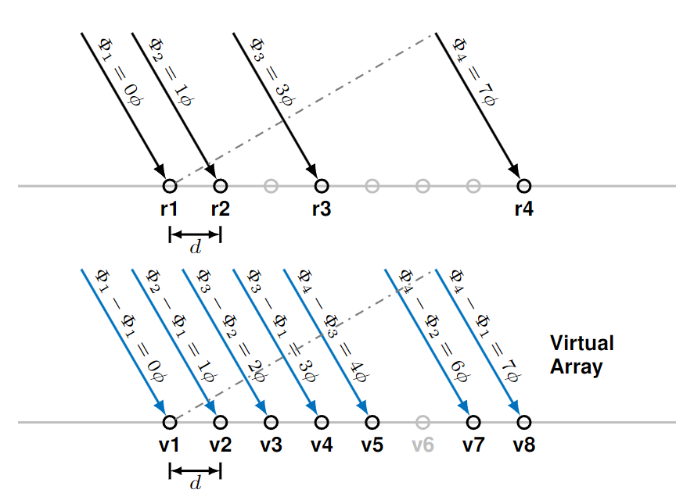
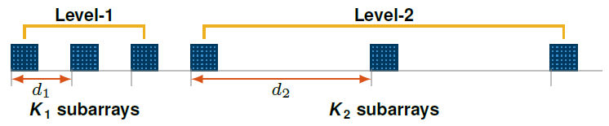
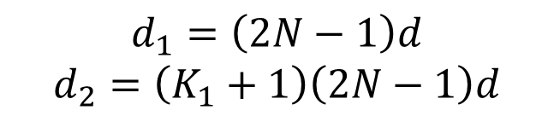
The Difference Co-Array (DCA)
Mostly employed in passive sensing.
Considers the differences in spatial locations of pairs of elements in a physical array.
Proposed DCA structure:
2-level Nested Array of Subarrays [1]
$$d_{1}=\left(2N−1\right)d$$
$$d_{2}=\left(K_{1}+1\right)\left(2N−1\right)d$$
[1] P. Pal and P. P. Vaidyanathan, “Nested arrays: A novel approach to array processing with enhanced degrees of freedom,” IEEE Transactions on Signal Processing, vol. 58, no. 8, pp. 4167–4181, 2010.
Notes:
The second type of the virtual array is the difference co-array. The difference co-array is mostly employed in passive sensing, where we only have control over an array of receiver antennas.
The DCA considers the differences in spatial locations of pairs of elements in a physical array.
For example, in this figure, 4 Rx antennas can synthesize a 7-element DCA.
For the hybRadar system, we draw inspiration from the nested arrays, and propose a 2-level nested array of subarray structure.
The key idea is that

Slide 13
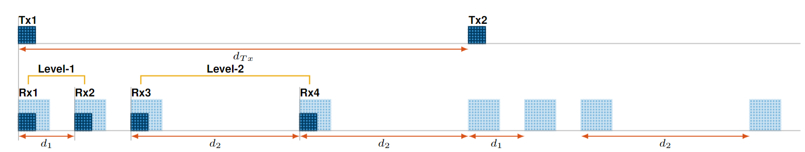
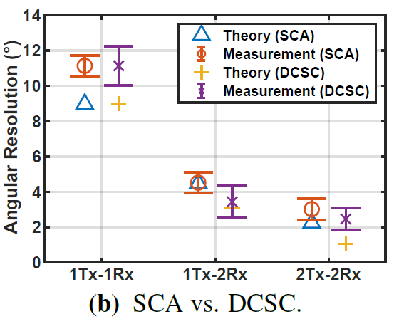
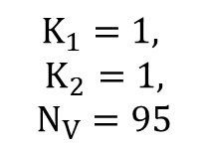
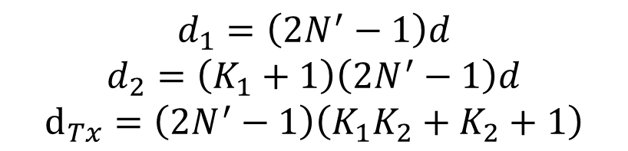
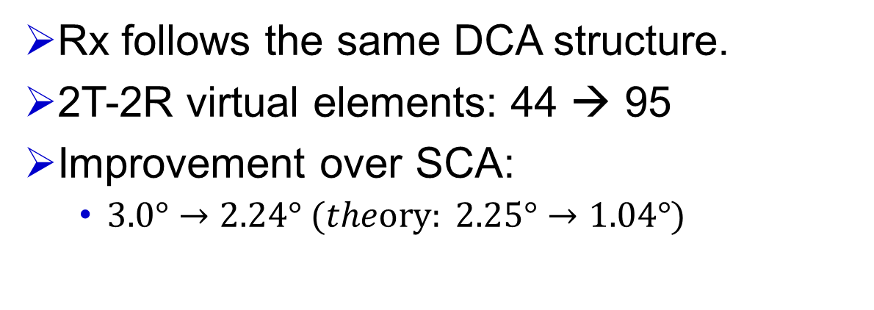
The Difference Co-array of Sum Co-array (DCSC)
DCSC = SCA + DCA; Proposed DCSC structure:
Linearly-spaced Tx Subarrays + Nested Rx Subarrays
$$K_{1}=1,$$
$$K_{2}=1,$$
$N_{V}=95$
$$d_{1}=\left(2N^{′}−1\right)d$$
$$d_{2}=\left(K_{1}+1\right)\left(2N^{′}−1\right)d$$
$$d_{Tx}=\left(2N^{′}−1\right)\left(K_{1}K_{2}+K_{2}+1\right)$$
Rx follows the same DCA structure.
2T-2R virtual elements: 44 → 95
Improvement over SCA:
$3.0°→2.24° (theory: 2.25°→1.04°)$
Notes:
Why not more Tx – Rx chain?

Slide 14
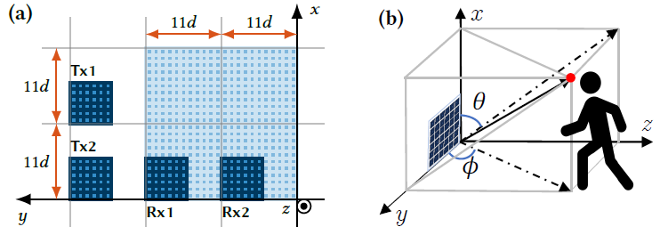
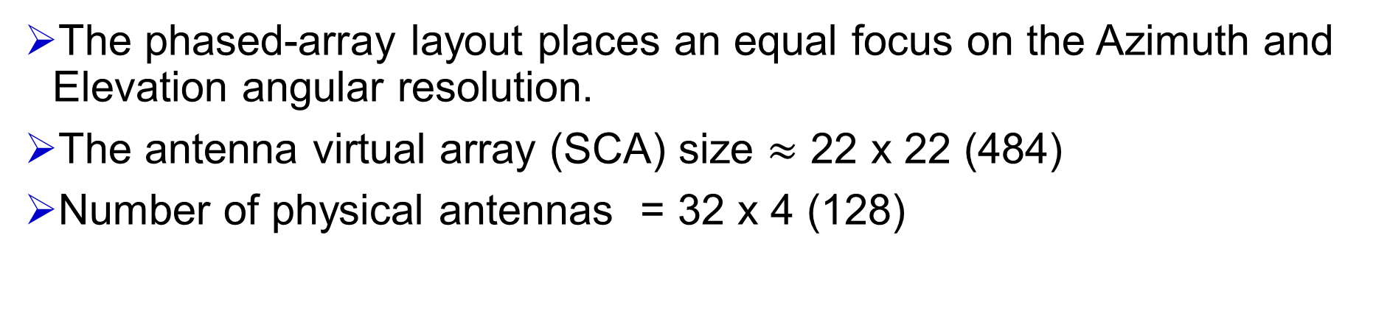
Case Study I: 3D Point Cloud
The phased-array layout places an equal focus on the Azimuth and Elevation angular resolution.
The antenna virtual array (SCA) size $≈$ 22 x 22 (484)
Number of physical antennas = 32 x 4 (128)
Notes:
We will further explore the capability of phased-MIMO radars by employing two case studies. The first one is the 3D point cloud.
In this case study, we place two Tx phased arrays in the vertical direction and two Rx phased arrays in the horizontal direction.
This layout places an equal focus on both the azimuth and elevation direction.
The resulting virtual array size is 22 by 22, which equals 484 antennas. This is much larger than the number of physical antennas.
Workflow: 2D beam scan → Range FFT → Virtual array synthesis → Angular analysis (MUSIC) → Point cloud synthesis.

Slide 15
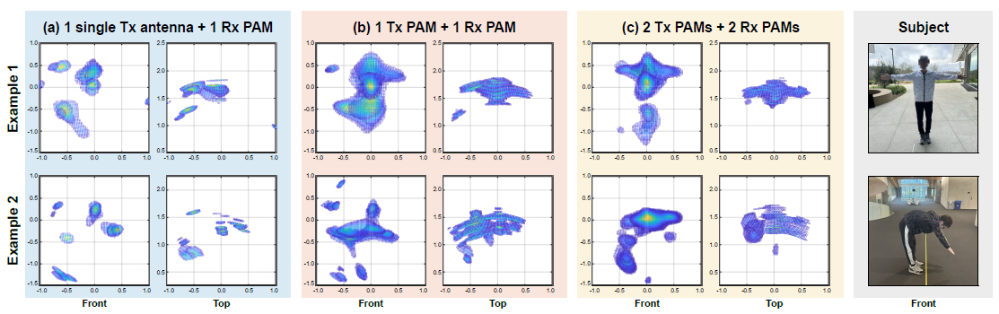
Case Study I: 3D Point Cloud
Subject @ 1.5m
Quality improves with more Tx/Rx antennas.
High-density point cloud with only 2Tx-2Rx RF chains.
Notes:
Here is the result of the 3D point cloud of a human subject.
The figure left is the result using one single Tx antenna and 1 Rx phased array. The middle one is 1Tx phased array plus 1Rx phased array. The right one is the 2Tx + 2Rx phased arrays.
As we can see, the quality improves with more Tx/Rx antennas.
We can achieve a high-density point cloud with only 2Tx-2Rx RF chains.

Slide 16
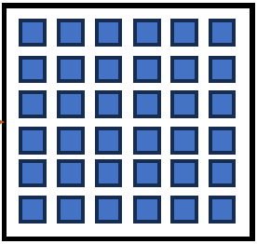
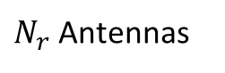
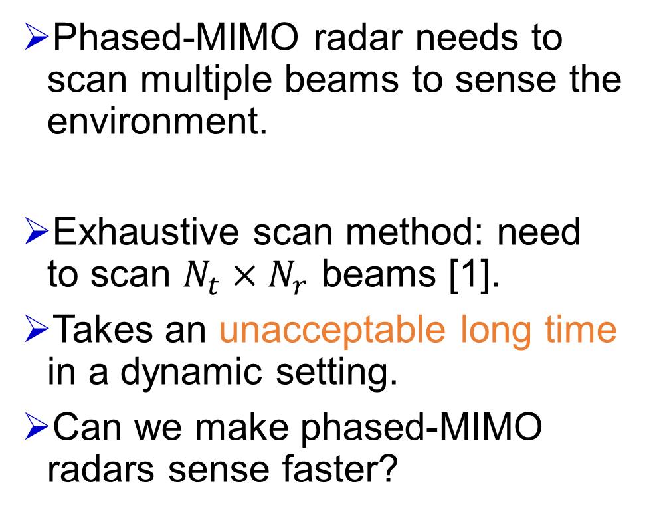
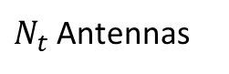
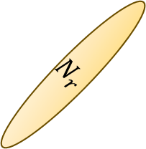
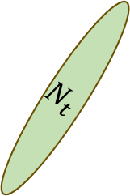
Case Study II: Compressive Sensing (CS)
Phased-MIMO radar needs to scan multiple beams to sense the environment.
Exhaustive scan method: need to scan $N_{t}×N_{r}$ beams [1].
Takes an unacceptable long time in a dynamic setting.
Can we make phased-MIMO radars sense faster?
2
$$N_{t}$$
2
1
1
$$N_{r}$$
…
…
Tx PAM
Rx PAM
$N_{t}$ Antennas
$N_{r}$ Antennas
[1] Zhang, Yu, Ling Huang, and Jian Song. "Phased array radar based angular domain channel estimation scheme for integrated radar-communication system." MILCOM 2016-2016 IEEE Military Communications Conference. IEEE, 2016.
Notes:
The second case study is compressive sensing.
Unlike a full-MIMO radar with a digital beamforming architecture, phased-MIMO needs to scan multiple beams to effectively sense the environment.
The baseline exhaustive scan method needs to scan N_t times N_r beams, as shown in the animation.
This process takes an unacceptable long time which impedes real-time sensing in dynamic environment.
So can we make phased-MIMO radar

Slide 17
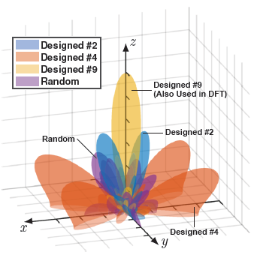
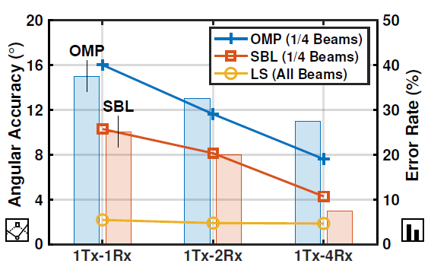
Case Study II: Compressive Sensing (CS)
CS exploits mmWave channel sparsity to reduce # of beams.
We design a CS codebook tailored for:
Large array of phased-arrays
Low resolution phased shifter (2 bits)
Experiment: estimate the angle of a single corner reflector at a random location (1.7~7.1m away).
We reduce the number of beams to 1/4 ~ 1/8 with acceptable accuracy.
4 degree angular accuracy, <8% error rate
Notes:
Compressive sensing exploits mmWave channel sparsity to reduce the number of beams.
In other words, “sparsity”
We design a CS codebook tailored for our unique hardware structure and array layout, which is 32-element array of phased-arrays, and 2bit phase shifter.
The designed beam patterns exhibit a random but still directional pattern.
To evaluate our codebook, we put a single corner reflector in the field of view of radar at a random location, and perform angular estimation.
Our result shows that we can achieve a 4 degree angular accuracy with less than 8% error rate with only a quarter of the total beams.
Corner reflector at random 40 positions, between 1.7m and 7.1m
full spatial coverage and inter-beam overlap.
Error: defined as when the estimated angle deviated from the ground truth by 10°

Slide 18
Summary
We proposed a mmWave radar platform with a phased-MIMO architecture with massive antennas.
Through effective sparse phased-array design, we achieved high angular resolution with a few RF-chains.
The 3D point cloud and compressive sensing case studies show the unique capability of phased-MIMO radars.
UCSD M3 software radio project: http://m3.ucsd.edu/sdr/
Schematics and PCB layout: https://github.com/kaizheng28/m3-radar

Slide 19
backups

Slide 20
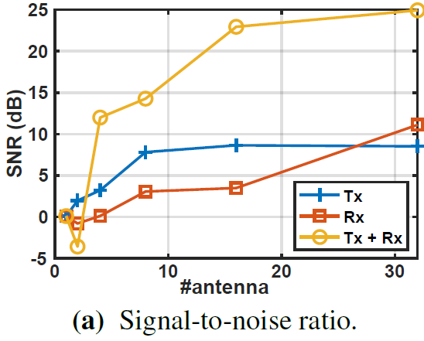


Evaluation: Array Gain
SNR and max. range increase with number of antennas.
Support short-to-mid range experiments.
Notes:
the required SNR to detect a target with a probability of 0.9 and a false detection rate of 10^3 is 11 dB

Slide 21










Case Study: Compressive Sensing (CS)
Goal: estimate all the radar backscatter channels between each Tx-Rx pairs ($N_{t}×N_{r}$).
Exhaustive scan method: need to scan all the combination of $N_{t}×N_{r}$ beams [1].
Unacceptable long time in a dynamic setting.
2
3
1
4
$$h_{11}$$
$$h_{12}$$
$$h_{13}$$
$$h_{14}$$
$$w_{1}$$
$$w_{2}$$
$$w_{3}$$
$$w_{4}$$
Tx1
+
$$y=\sum_{i=1}^{N}{w_{i}h_{i}s}$$
Rx1
[1] Zhang, Yu, Ling Huang, and Jian Song. "Phased array radar based angular domain channel estimation scheme for integrated radar-communication system." MILCOM 2016-2016 IEEE Military Communications Conference. IEEE, 2016.
Notes:
For FMCW radar, the channel h corresponds to each range bin.

Slide 22



Angular Resolution Measurement
With a 2Tx-2Rx phased-array setup
SCA: 3.0°angular resolution
DCSC: 2.4°angular resolution
Angular resolution (beamforming): $θ_{res}≈0.89\frac{λ}{Ndcosθ}$
Antenna spacing $d=0.58λ$

